Slide 1

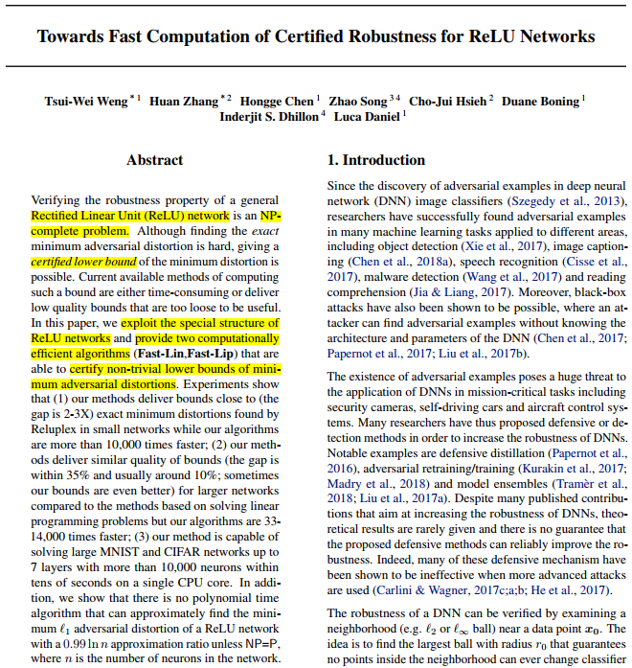
2nd
Towards Fast Computation of Certified Robustness for ReLU Networks
(Local Lipschitz Constant )
Tsui-Wei Weng, Hongge Chen,…, Luca Daniel
Massachusetts Institute of Technology
ICML 2018

Slide 2
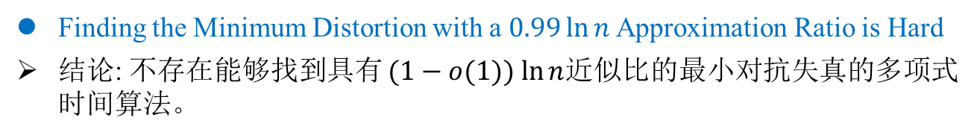
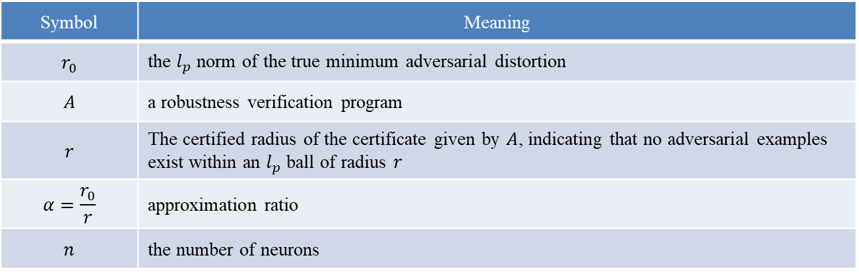
Lipschitz Constant
Motivating Theorem
Finding the Minimum Distortion with a $0.99\ln{n}$Approximation Ratio is Hard
结论: 不存在能够找到具有 $(1−o(1)) ln⁡n$近似比的最小对抗失真的多项式时间算法。
Symbol | Meaning
$$r_{0}$$ | the $l_{p}$ norm of the true minimum adversarial distortion
$$A$$ | a robustness verification program
$$r$$ | The certified radius of the certificate given by $A$, indicating that no adversarial examples exist within an $l_{p}$ ball of radius $r$
$$α=\frac{r_{0}}{r}$$ | approximation ratio
$$n$$ | the number of neurons
Weng Lily, Hongge Chen, Luca Daniel. Towards fast computation of certified robustness for ReLU networks. ICML. 2018.

Slide 3
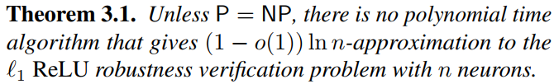
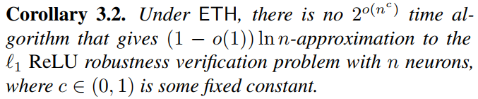

Lipschitz Constant
Motivating Theorem
Finding the Minimum Distortion with a $0.99\ln{n}$Approximation Ratio is Hard
定理 3.1 意味着任何多项式时间算法都不能提供比 $(1−o(1)) ln⁡n$逼近更好的保证。
指数时间假设 (Exponential Time Hypothesis, ETH)
Weng Lily, Hongge Chen, Luca Daniel. Towards fast computation of certified robustness for ReLU networks. ICML. 2018.

Slide 4

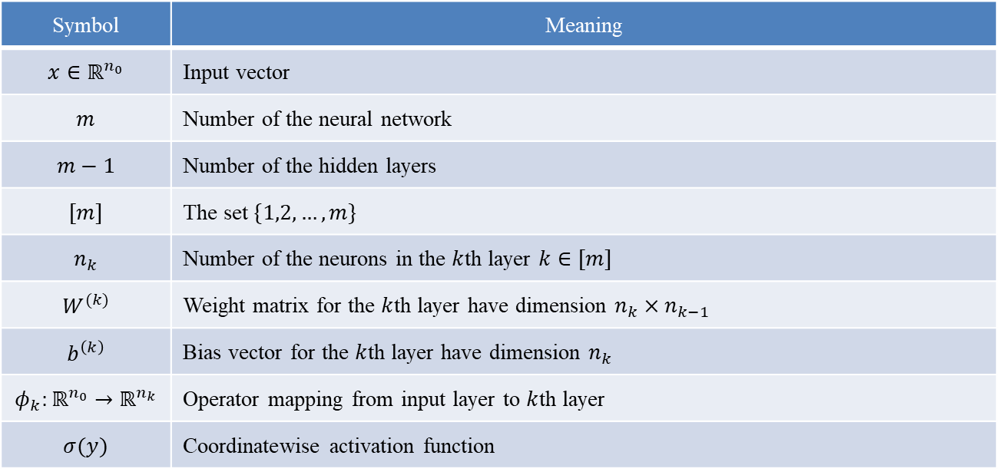
Lipschitz Constant
Notation
ReLU Networks and Their Activation Patterns
Relation between $k−1$ layer $k$th layer: $φ_{k}\left(x\right)=σ(W^{\left(k\right)}∙φ_{k−1}\left(x\right)+b^{\left(k\right)})$
Symbol | Meaning
$$x∈ℝ^{n_{0}}$$ | Input vector
$$m$$ | Number of the neural network
$$m−1$$ | Number of the hidden layers
$$[m]$$ | The set $\{1,2,…,m\}$
$$n_{k}$$ | Number of the neurons in the $k$th layer $k∈[m]$
$$W^{(k)}$$ | Weight matrix for the $k$th layer have dimension $n_{k}×n_{k−1}$
$$b^{\left(k\right)}$$ | Bias vector for the $k$th layer have dimension $n_{k}$
$$φ_{k}:ℝ^{n_{0}}→ℝ^{n_{k}}$$ | Operator mapping from input layer to $k$th layer
$$σ(y)$$ | Coordinatewise activation function
Weng Lily, Hongge Chen, Luca Daniel. Towards fast computation of certified robustness for ReLU networks. ICML. 2018.

Slide 5

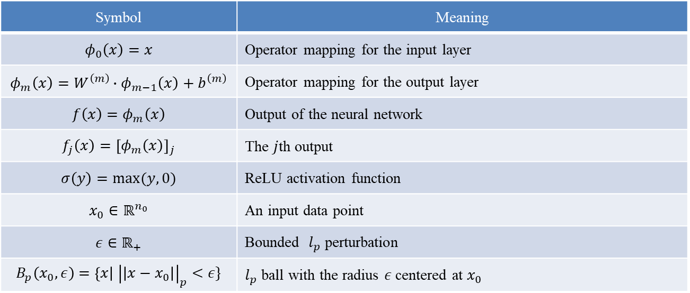
Lipschitz Constant
Notation
ReLU Networks and Their Activation Patterns
Input $x$ is constrained in $B_{p}\left(x_{0},ε\right)$
Symbol | Meaning
$$φ_{0}\left(x\right)=x$$ | Operator mapping for the input layer
$$φ_{m}\left(x\right)=W^{\left(m\right)}∙φ_{m−1}\left(x\right)+b^{\left(m\right)}$$ | Operator mapping for the output layer
$$f\left(x\right)=φ_{m}\left(x\right)$$ | Output of the neural network
$$f_{j}\left(x\right)={\left[φ_{m}\left(x\right)\right]}_{j}$$ | The $j$th output
$$σ\left(y\right)=\max{(y,0)}$$ | ReLU activation function
$$x_{0}∈ℝ^{n_{0}}$$ | An input data point
$$ε∈ℝ_{+}$$ | Bounded $l_{p}$ perturbation
$$B_{p}\left(x_{0},ε\right)=\left\{x\right| {\left|\left|x−x_{0}\right|\right|}_{p}<ε\}$$ | $l_{p}$ ball with the radius $ε$ centered at $x_{0}$
Weng Lily, Hongge Chen, Luca Daniel. Towards fast computation of certified robustness for ReLU networks. ICML. 2018.

Slide 6

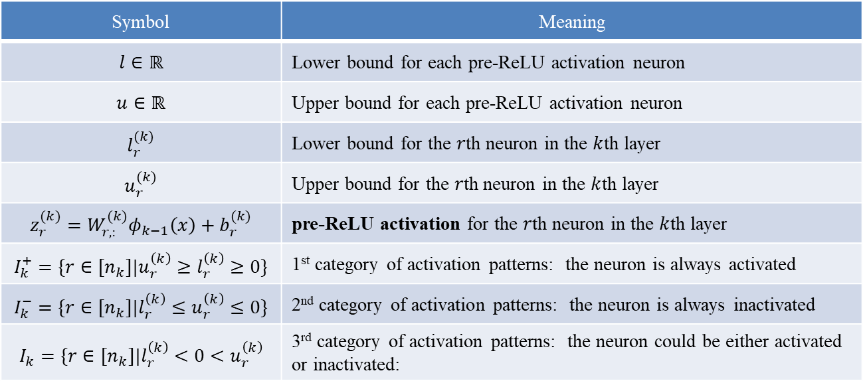
Lipschitz Constant
Notation
ReLU Networks and Their Activation Patterns
$l_{r}^{(k)}≤z_{r}^{(k)}≤u_{r}^{(k)}$
$\left\{I_{k}^{+},I_{k}^{−},I_{k}\right\}⊆[n_{k}]$
Symbol | Meaning
$$l∈ℝ$$ | Lower bound for each pre-ReLU activation neuron
$$u∈ℝ$$ | Upper bound for each pre-ReLU activation neuron
$$l_{r}^{(k)}$$ | Lower bound for the $r$th neuron in the $k$th layer
$$u_{r}^{(k)}$$ | Upper bound for the $r$th neuron in the $k$th layer
$$z_{r}^{(k)}=W_{r,:}^{(k)}φ_{k−1}\left(x\right)+b_{r}^{(k)}$$ | pre-ReLU activation for the $r$th neuron in the $k$th layer
$$I_{k}^{+}=\{r∈[n_{k}]|u_{r}^{\left(k\right)}≥l_{r}^{\left(k\right)}≥0\}$$ | 1st category of activation patterns: the neuron is always activated
$$I_{k}^{−}=\{r∈[n_{k}]|l_{r}^{\left(k\right)}≤u_{r}^{\left(k\right)}≤0\}$$ | 2nd category of activation patterns: the neuron is always inactivated
$$I_{k}=\{r∈[n_{k}]|l_{r}^{\left(k\right)}<0<u_{r}^{\left(k\right)}$$ | 3rd category of activation patterns: the neuron could be either activated or inactivated:
Weng Lily, Hongge Chen, Luca Daniel. Towards fast computation of certified robustness for ReLU networks. ICML. 2018.

Slide 7






Lipschitz Constant
Fast-Lin
Approach 1 (Fast-Lin): Certified Lower Bounds via Linear Approximations
Derivation of the Output Bounds via Linear Upper And Lower Bounds for ReLU
结论：面对$l_{p}$范数扰动，通过线性近似可以推导出ReLU网络的输出边界；通过对输出边界的分析可以快速计算鲁棒认证的下限。
The $j$th output of a 2-layer network:
For $r∈I_{k}^{+}$,
For $r∈I_{k}^{−}$,
For $r∈I_{k}$, use the following linear upper bound and a linear lower bound to replace the ReLU activation $σ(y)$:
Weng Lily, Hongge Chen, Luca Daniel. Towards fast computation of certified robustness for ReLU networks. ICML. 2018.

Slide 8
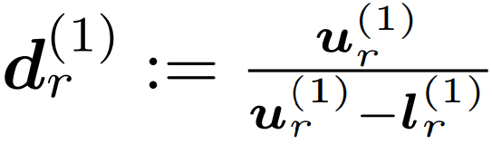
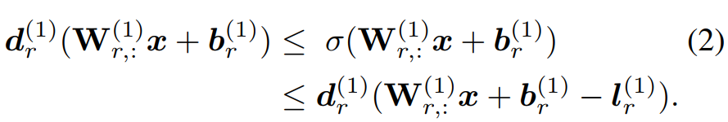
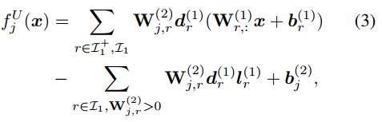
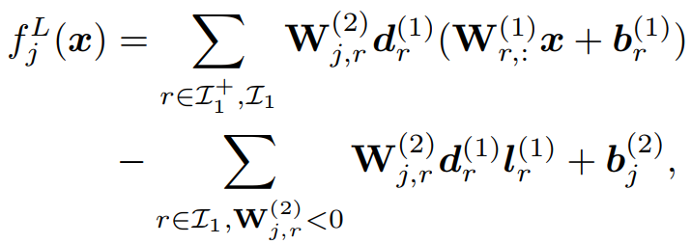

Lipschitz Constant
Fast-Lin
Approach 1 (Fast-Lin): Certified Lower Bounds via Linear Approximations
Derivation of the Output Bounds via Linear Upper And Lower Bounds for ReLU
Let ,
Set for $r∈I_{1}^{+}$
$f_{j}^{L}\left(x\right)≤f_{j}\left(x\right)≤f_{j}^{U}(x)$
(2)
(3)
(4)
Weng Lily, Hongge Chen, Luca Daniel. Towards fast computation of certified robustness for ReLU networks. ICML. 2018.

Slide 9
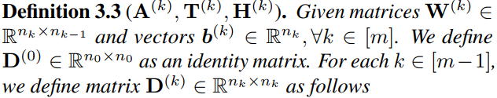
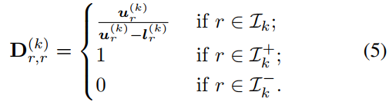
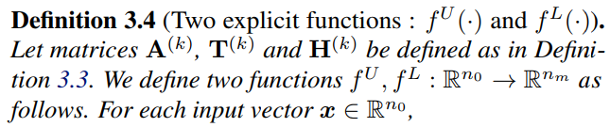
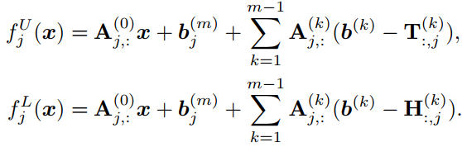
Lipschitz Constant
Fast-Lin
Approach 1 (Fast-Lin): Certified Lower Bounds via Linear Approximations
Derivation of the Output Bounds via Linear Upper And Lower Bounds for ReLU
Weng Lily, Hongge Chen, Luca Daniel. Towards fast computation of certified robustness for ReLU networks. ICML. 2018.

Slide 10
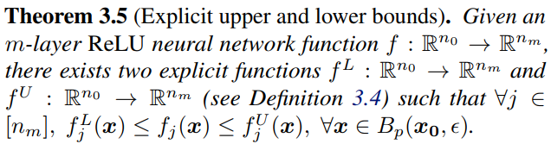
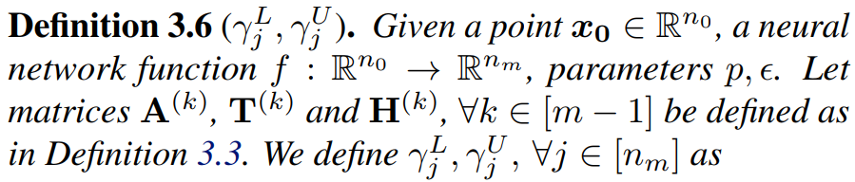
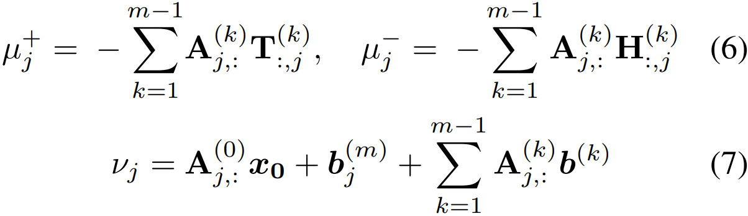
Lipschitz Constant
Fast-Lin
Approach 1 (Fast-Lin): Certified Lower Bounds via Linear Approximations
Derivation of the Output Bounds via Linear Upper And Lower Bounds for ReLU
Weng Lily, Hongge Chen, Luca Daniel. Towards fast computation of certified robustness for ReLU networks. ICML. 2018.

Slide 11
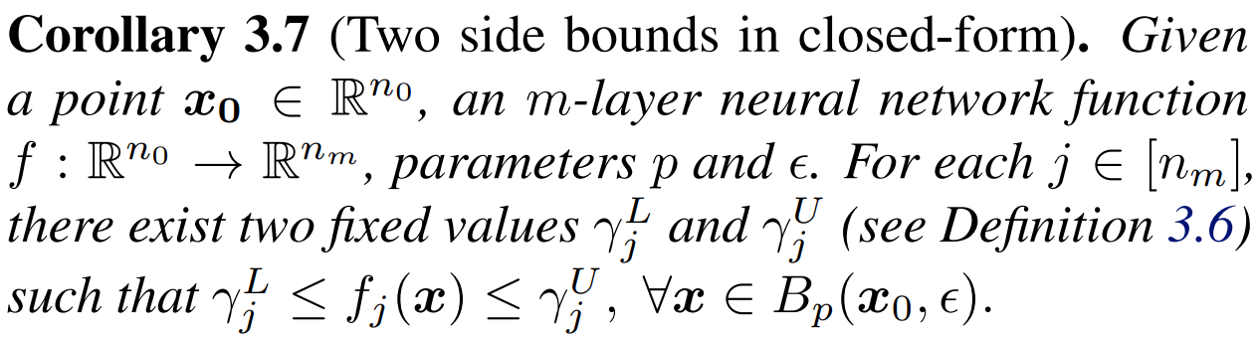
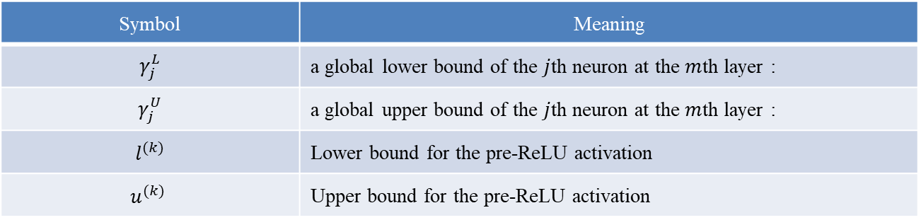
Lipschitz Constant
Fast-Lin
Approach 1 (Fast-Lin): Certified Lower Bounds via Linear Approximations
Derivation of the Output Bounds via Linear Upper And Lower Bounds for ReLU
Symbol | Meaning
$$γ_{j}^{L}$$ | a global lower bound of the $j$th neuron at the $m$th layer :
$$γ_{j}^{U}$$ | a global upper bound of the $j$th neuron at the $m$th layer :
$$l^{(k)}$$ | Lower bound for the pre-ReLU activation
$$u^{(k) }$$ | Upper bound for the pre-ReLU activation
Weng Lily, Hongge Chen, Luca Daniel. Towards fast computation of certified robustness for ReLU networks. ICML. 2018.

Slide 12
Lipschitz Constant
Fast-Lin
Approach 1 (Fast-Lin): Certified Lower Bounds via Linear Approximations
Deriving Maximum Certified Lower Bounds of Minimum Adversarial Distortion
Weng Lily, Hongge Chen, Luca Daniel. Towards fast computation of certified robustness for ReLU networks. ICML. 2018.

Slide 13
Lipschitz Constant
Fast-Lin
Approach 1 (Fast-Lin): Certified Lower Bounds via Linear Approximations
Discussions
Weng Lily, Hongge Chen, Luca Daniel. Towards fast computation of certified robustness for ReLU networks. ICML. 2018.

Slide 14
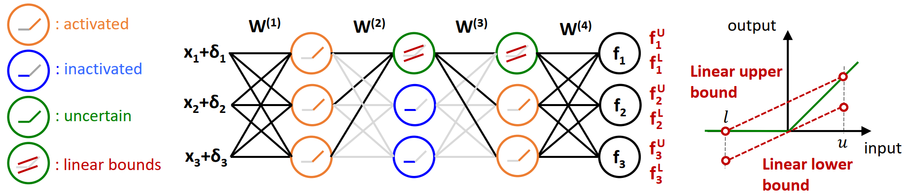

Lipschitz Constant
Fast-Lin
Approach 1 (Fast-Lin): Certified Lower Bounds via Linear Approximations
Illustration of deriving output bounds for ReLU networks via Fast-Lin
The final output upper bounds ($f_{j}^{U}$) and lower bounds ($f_{j}^{L}$) can be derived by considering the activation status of neurons with input perturbation ${\left|\left|δ\right|\right|}_{p}≤ε$.
For neurons in $I_{k}^{+}$, their outputs are identical to their inputs (输出等价输入).
For neurons in $I_{k}^{−}$, they can be removed during computation as their outputs are always zero (负半轴因为激活输出总是0所以可以移除计算).
For neurons in $I_{k}$, their outputs can be bounded by corresponding linear upper bounds and lower bounds considering the signs (符号) of associated weights.
Weng Lily, Hongge Chen, Luca Daniel. Towards fast computation of certified robustness for ReLU networks. ICML. 2018.

Slide 15
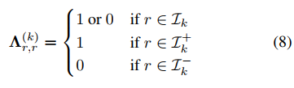

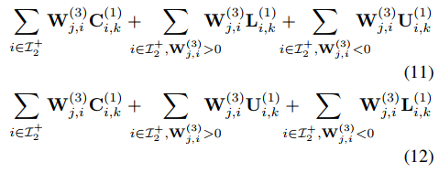
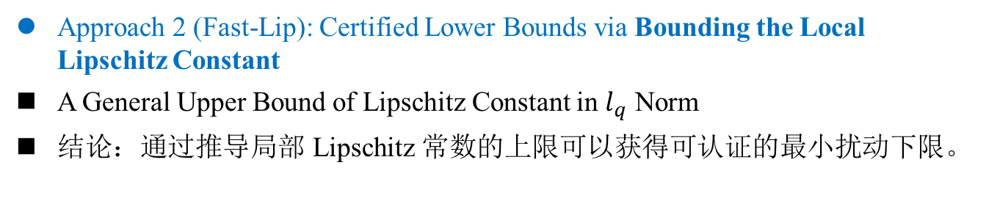
Lipschitz Constant
Fast-Lip
Approach 2 (Fast-Lip): Certified Lower Bounds via Bounding the Local Lipschitz Constant
A General Upper Bound of Lipschitz Constant in $l_{q}$ Norm
结论：通过推导局部 Lipschitz 常数的上限可以获得可认证的最小扰动下限。
Weng Lily, Hongge Chen, Luca Daniel. Towards fast computation of certified robustness for ReLU networks. ICML. 2018.

Slide 16
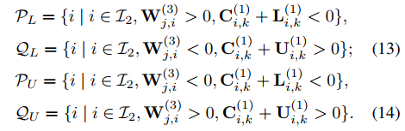


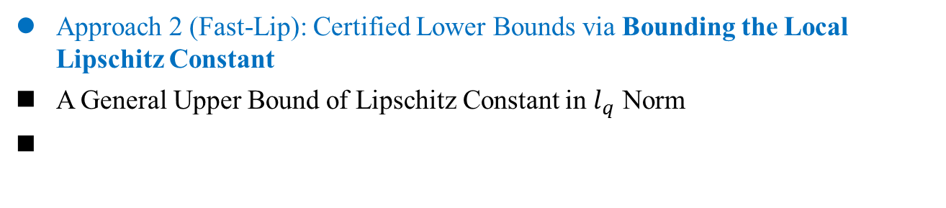
Lipschitz Constant
Fast-Lip
Approach 2 (Fast-Lip): Certified Lower Bounds via Bounding the Local Lipschitz Constant
A General Upper Bound of Lipschitz Constant in $l_{q}$ Norm
Weng Lily, Hongge Chen, Luca Daniel. Towards fast computation of certified robustness for ReLU networks. ICML. 2018.

Slide 17
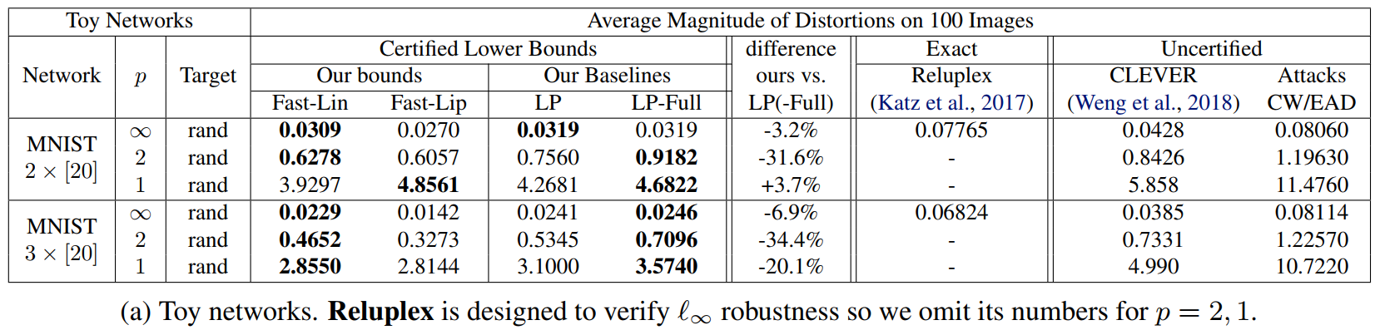
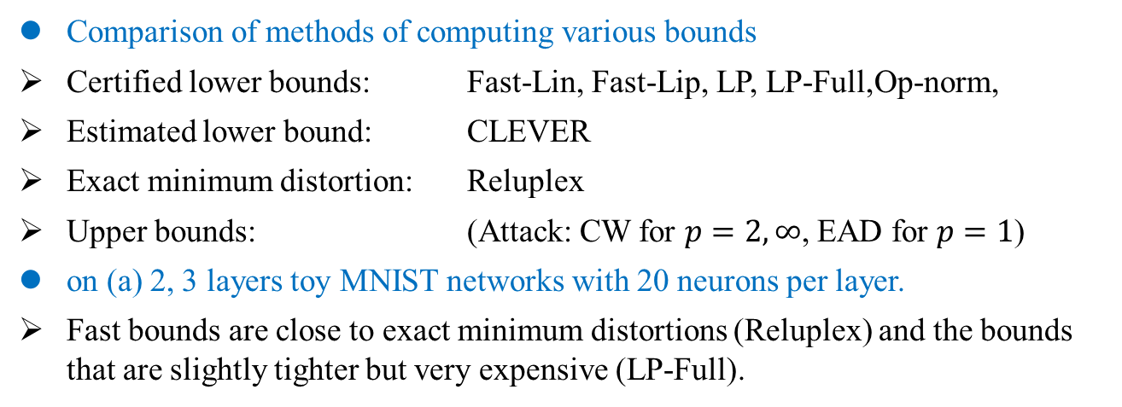
Lipschitz Constant
Experiments
Comparison of methods of computing various bounds
Certified lower bounds: Fast-Lin, Fast-Lip, LP, LP-Full,Op-norm,
Estimated lower bound: CLEVER
Exact minimum distortion: Reluplex
Upper bounds: (Attack: CW for $p=2, ∞$, EAD for $p=1$)
on (a) 2, 3 layers toy MNIST networks with 20 neurons per layer.
Fast bounds are close to exact minimum distortions (Reluplex) and the bounds that are slightly tighter but very expensive (LP-Full).
Weng Lily, Hongge Chen, Luca Daniel. Towards fast computation of certified robustness for ReLU networks. ICML. 2018.

Slide 18
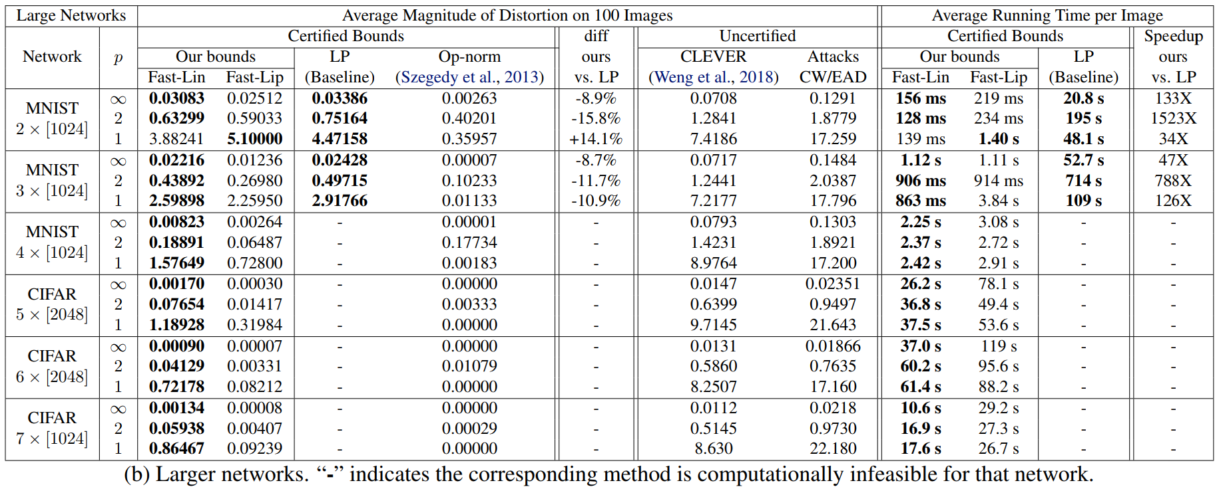
Lipschitz Constant
Experiments
Comparison of methods of computing various bounds on (b) large networks with 2-7 layers, 1024 or 2048 nodes per layer.
Differences of lower bounds and speedup are measured on the best bound from proposed algorithms and LP-based approaches (the bold numbers in each row).
LP-Full and Reluplex are computationally infeasible for all the networks.
Weng Lily, Hongge Chen, Luca Daniel. Towards fast computation of certified robustness for ReLU networks. ICML. 2018.

Slide 19
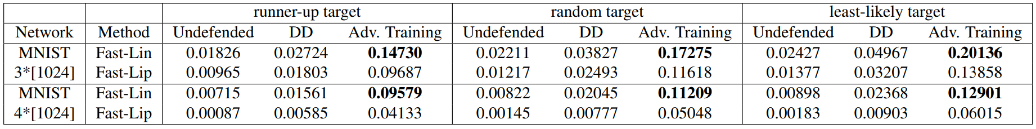
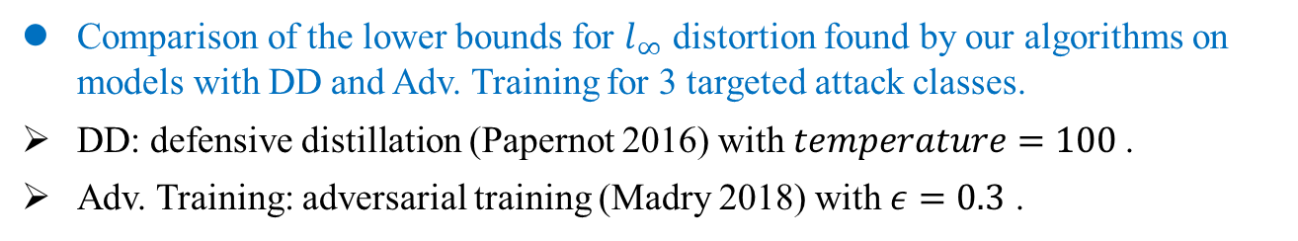
Lipschitz Constant
Experiments
Comparison of the lower bounds for $l_{∞}$ distortion found by our algorithms on models with DD and Adv. Training for 3 targeted attack classes.
DD: defensive distillation (Papernot 2016) with $temperature=100$.
Adv. Training: adversarial training (Madry 2018) with $ε=0.3$ .
Weng Lily, Hongge Chen, Luca Daniel. Towards fast computation of certified robustness for ReLU networks. ICML. 2018.

Slide 20
Lipschitz Constant
Conclusion
In this paper we have considered the problem of verifying the robustness property of ReLU networks.
本文考虑了验证 ReLU 网络鲁棒性的问题。
By exploiting the special properties of ReLU networks, we have here presented two computational efficient methods Fast-Lin and Fast-Lip for this problem.
通过利用 ReLU 网络的特殊性质，我们在提出了两种计算效率高的方法: Fast-Lin 和 Fast-Lip 。
Our algorithms are two orders of magnitude (or more) faster than LP-based methods, while obtaining solutions with similar quality; meanwhile, our bounds qualities are much better than the previously proposed operator-norm based methods.
比基于 LP 的方法快两个数量级；同时获得具有相似质量的解决方案；同时边界质量比之前提出的基于算子范数的方法好得多。
Additionally, our methods are efficient and easy to implement: we compute the bounds layer-by-layer, and the computation cost for each layer is similar to the cost of matrix products in forward propagation; moreover, we do not need to solve any integer programming, linear programming or their duals.
高效且易于实现：逐层计算边界，每一层的计算成本类似于前向传播中矩阵乘积的成本；此外，不需要解决任何整数规划、线性规划问题或它们的对偶问题。
Weng Lily, Hongge Chen, Luca Daniel. Towards fast computation of certified robustness for ReLU networks. ICML. 2018.

